Slide 1


William Stallings Computer Organization and Architecture 8th Edition
Chapter 4
Cache Memory
Book by : Computer, Architecture and Organizations, 8th Edition ,William Stalling
Original Slides by : Adrian J Pullin

Slide 2
Cache Memory

Slide 3
Lecture Outcomes
Understanding of:
Computer Memory System
Cache Memory principles
Elements of Cache Design
Mapping Function

Slide 4
Characteristics
Location
Capacity
Unit of transfer
Access method
Performance
Physical type
Physical characteristics
Organisation

Slide 5
Location
CPU
Internal
External

Slide 6
Capacity
Word size
The natural unit of organisation
Number of words
or Bytes

Slide 7
Unit of Transfer
Internal
Usually governed by data bus width
External
Usually a block which is much larger than a word
Addressable unit
Smallest location which can be uniquely addressed
Word internally

Slide 8
Access Methods (1)
Sequential
Start at the beginning and read through in order
Access time depends on location of data and previous location
e.g. tape
Direct
Individual blocks have unique address
Access is by jumping to vicinity plus sequential search
Access time depends on location and previous location
e.g. disk

Slide 9
Access Methods (2)
Random
Individual addresses identify locations exactly
Access time is independent of location or previous access
e.g. RAM
Associative
Data is located by a comparison with contents of a portion of the store
Access time is independent of location or previous access
e.g. cache

Slide 10
Memory Hierarchy
Registers
In CPU
Internal or Main memory
May include one or more levels of cache
“RAM”
External memory
Backing store

Slide 11
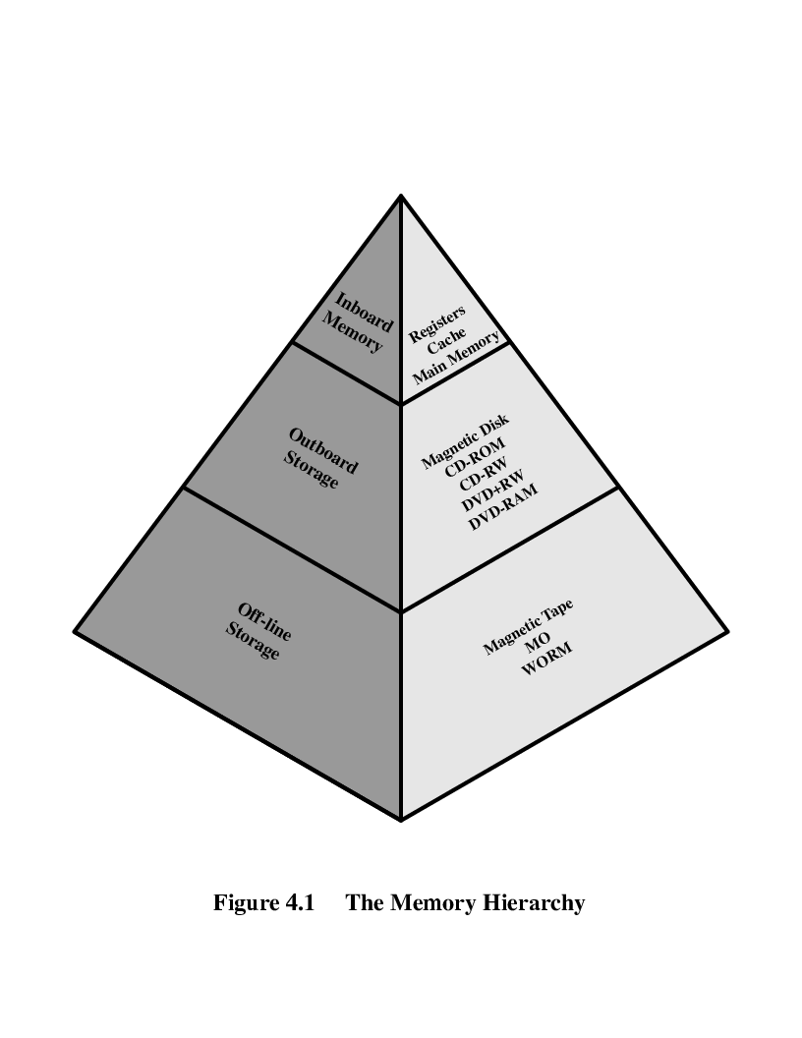
Memory Hierarchy - Diagram

Slide 12
Performance
Access time
Time between presenting the address and getting the valid data
Memory Cycle time
Time may be required for the memory to “recover” before next access
Cycle time is access + recovery
Transfer Rate
Rate at which data can be moved

Slide 13
Physical Types
Semiconductor
RAM
Magnetic
Disk & Tape
Optical
CD & DVD
Others
Bubble
Hologram

Slide 14
Physical Characteristics
Decay
Volatility
Erasable
Power consumption

Slide 15
Organization
Physical arrangement of bits into words
Not always obvious
e.g. interleaved

Slide 16
The Bottom Line
How much?
Capacity
How fast?
Time is money
How expensive?

Slide 17
Hierarchy List
Registers
L1 Cache
L2 Cache
Main memory
Disk cache
Disk
Optical
Tape

Slide 18
So you want fast?
It is possible to build a computer which uses only static RAM (see later)
This would be very fast
This would need no cache
How can you cache cache?
This would cost a very large amount

Slide 19
Cache
Small amount of fast memory
Sits between normal main memory and CPU
May be located on CPU chip or module

Slide 20
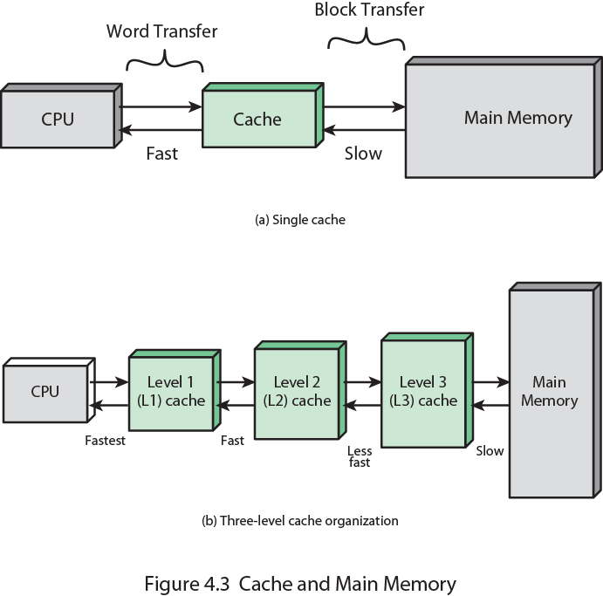
Cache and Main Memory

Slide 21
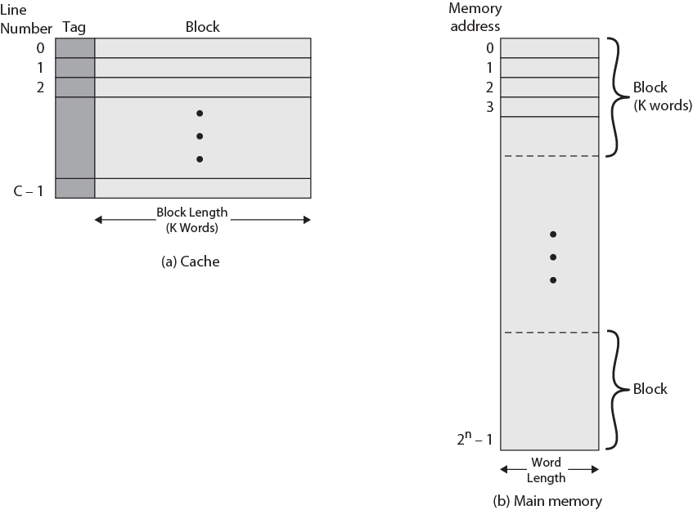
Cache/Main Memory Structure

Slide 22
Cache operation – overview
CPU requests contents of memory location
Check cache for this data
If present, get from cache (fast)
If not present, read required block from main memory to cache
Then deliver from cache to CPU
Cache includes tags to identify which block of main memory is in
each cache slot

Slide 23
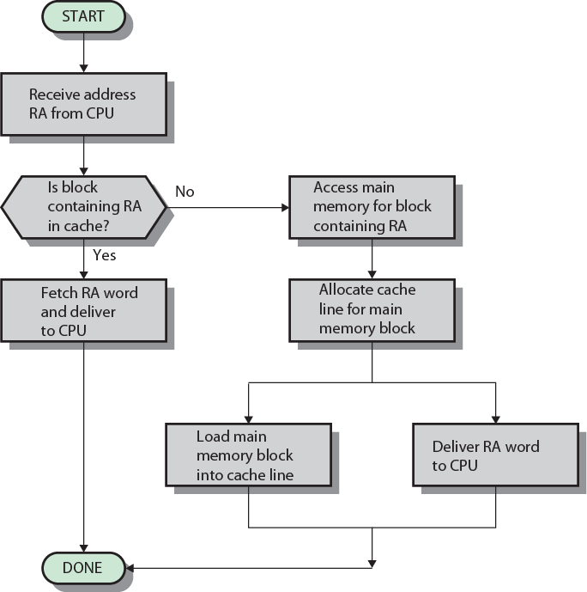
Cache Read Operation - Flowchart

Slide 24
Cache Design
Addressing
Size
Mapping Function
Replacement Algorithm
Write Policy
Block Size
Number of Caches

Slide 25
Cache Addressing
Where does cache sit?
Between processor and virtual memory management unit
Between MMU and main memory
Logical cache (virtual cache) stores data using virtual addresses
Processor accesses cache directly, not thorough physical cache
Cache access faster, before MMU address translation
Virtual addresses use same address space for different applications
Must flush cache on each context switch
Physical cache stores data using main memory physical addresses

Slide 26
Size does matter
Cost
More cache is expensive
Speed
More cache is faster (up to a point)
Checking cache for data takes time

Slide 27
Comparison of Cache Sizes
Processor
Type
Year of Introduction
L1 cache
L2 cache
L3 cache
IBM 360/85
Mainframe
1968
16 to 32 KB
—
—
PDP-11/70
Minicomputer
1975
1 KB
—
—
VAX 11/780
Minicomputer
1978
16 KB
—
—
IBM 3033
Mainframe
1978
64 KB
—
—
IBM 3090
Mainframe
1985
128 to 256 KB
—
—
Intel 80486
PC
1989
8 KB
—
—
Pentium
PC
1993
8 KB/8 KB
256 to 512 KB
—
PowerPC 601
PC
1993
32 KB
—
—
PowerPC 620
PC
1996
32 KB/32 KB
—
—
PowerPC G4
PC/server
1999
32 KB/32 KB
256 KB to 1 MB
2 MB
IBM S/390 G4
Mainframe
1997
32 KB
256 KB
2 MB
IBM S/390 G6
Mainframe
1999
256 KB
8 MB
—
Pentium 4
PC/server
2000
8 KB/8 KB
256 KB
—
IBM SP
High-end server/ supercomputer
2000
64 KB/32 KB
8 MB
—
CRAY MTAb
Supercomputer
2000
8 KB
2 MB
—
Itanium
PC/server
2001
16 KB/16 KB
96 KB
4 MB
SGI Origin 2001
High-end server
2001
32 KB/32 KB
4 MB
—
Itanium 2
PC/server
2002
32 KB
256 KB
6 MB
IBM POWER5
High-end server
2003
64 KB
1.9 MB
36 MB
CRAY XD-1
Supercomputer
2004
64 KB/64 KB
1MB
—

Slide 28
Mapping Function
Cache of 64kByte
Cache block of 4 bytes
i.e. cache is 16k (2¹⁴) lines of 4 bytes
16MBytes main memory
24 bit address
(2²⁴=16M)

Slide 29
Direct Mapping
Each block of main memory maps to only one cache line
i.e. if a block is in cache, it must be in one specific place
Address is in two parts
Least Significant w bits identify unique word
Most Significant s bits specify one memory block
The MSBs are split into a cache line field r and a tag of s-r (most significant)

Slide 30
Direct Mapping Address Structure
Tag s-r
Line or Slot r
Word w
8
14
2
24 bit address
2 bit word identifier (4 byte block)
22 bit block identifier
8 bit tag (=22-14)
14 bit slot or line
No two blocks in the same line have the same Tag field
Check contents of cache by finding line and checking Tag

Slide 31
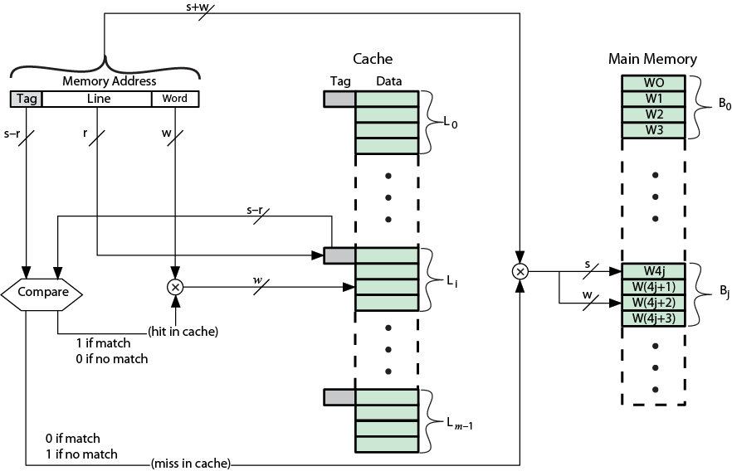
Direct Mapping Cache Organization

Slide 32
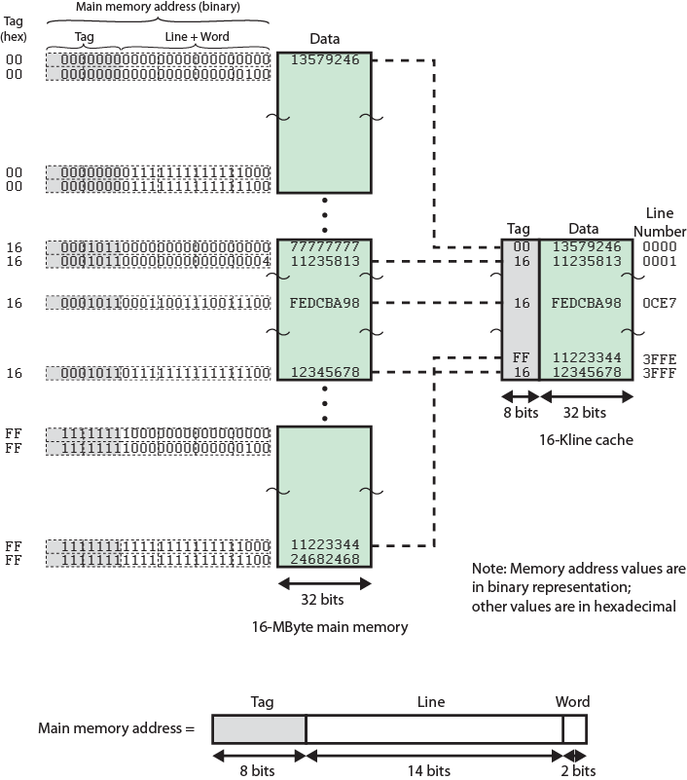
Direct Mapping Example

Slide 33
Direct Mapping Summary
Address length = (s + w) bits
Number of addressable units = 2s+w words or bytes
Block size = line size = 2w words or bytes
Number of blocks in main memory = 2s+ w/2w = 2s
Number of lines in cache = m = 2r
Size of tag = (s – r) bits

Slide 34
Direct Mapping pros & cons
Simple
Inexpensive
Fixed location for given block
If a program accesses 2 blocks that map to the same line repeatedly, cache misses are very high

Slide 35
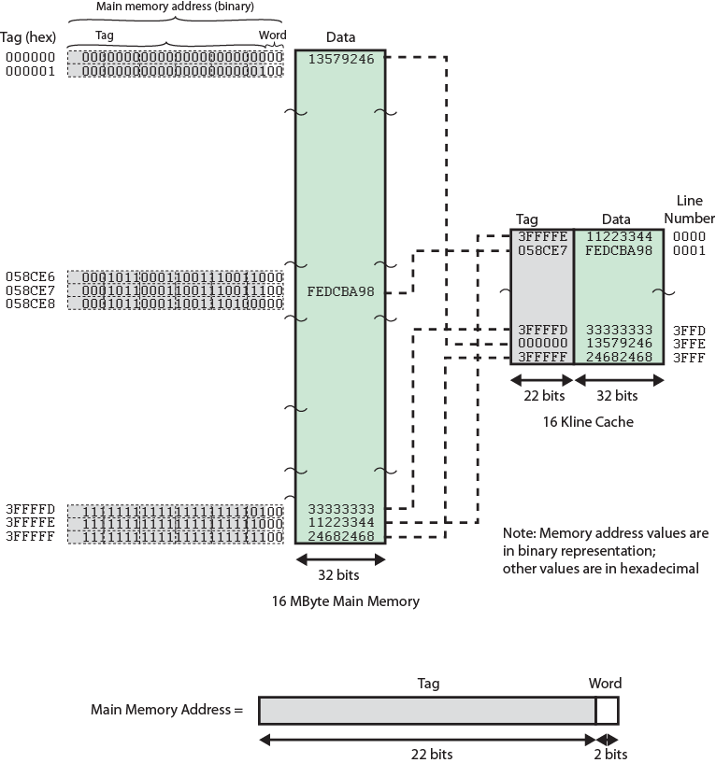
Associative Mapping Example
Associative
Mapping Example

Slide 36
Associative Mapping Address Structure
Tag 22 bit
Word
2 bit
22 bit tag stored with each 32 bit block of data
Compare tag field with tag entry in cache to check for hit
Least significant 2 bits of address identify which 16 bit word is required from 32 bit data block
e.g.
Address Tag Data Cache line
FFFFFC FFFFFC 24682468 3FFF

Slide 37
Associative Mapping Summary
Address length = (s + w) bits
Number of addressable units = 2s+w words or bytes
Block size = line size = 2w words or bytes
Number of blocks in main memory = 2s+ w/2w = 2s
Number of lines in cache = undetermined
Size of tag = s bits

Slide 38
Set Associative Mapping
Cache is divided into a number of sets
Each set contains a number of lines
A given block maps to any line in a given set
e.g. Block B can be in any line of set i
e.g. 2 lines per set
2 way associative mapping
A given block can be in one of 2 lines in only one set

Slide 39
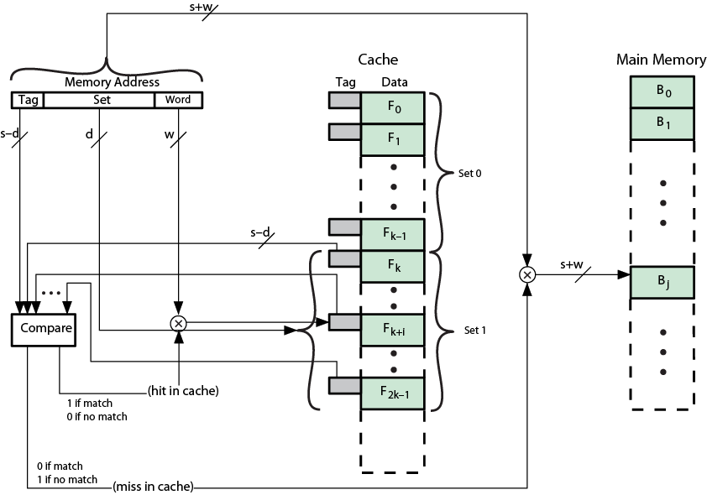
K-Way Set Associative Cache Organization

Slide 40
Set Associative Mapping Address Structure
Word
2 bit
Tag 9 bit
Set 13 bit
Use set field to determine cache set to look in
Compare tag field to see if we have a hit
e.g
Address Tag Data Set number
1FF 7FFC 1FF 12345678 1FFF
001 7FFC 001 11223344 1FFF

Slide 41
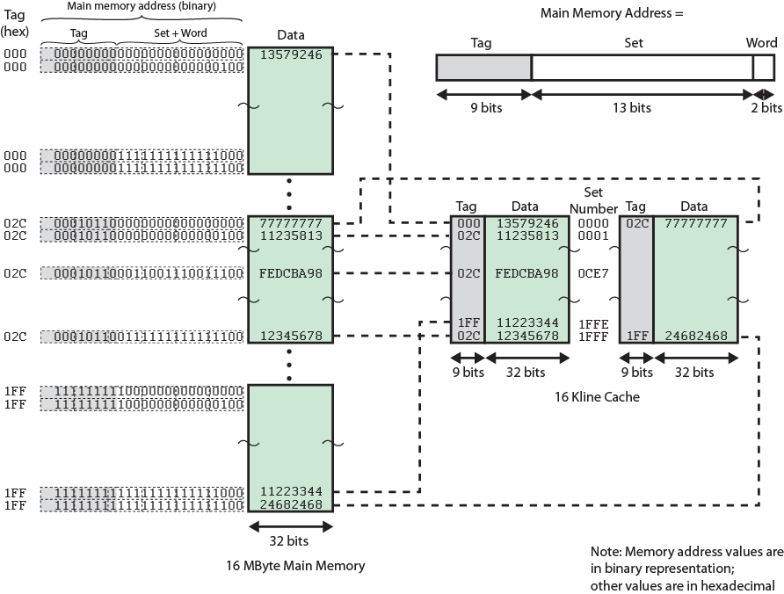
Two Way Set Associative Mapping Example

Slide 42
Set Associative Mapping Summary
Address length = (s + w) bits
Number of addressable units = 2s+w words or bytes
Block size = line size = 2w words or bytes
Number of blocks in main memory = 2d
Number of lines in set = k
Number of sets = v = 2d
Number of lines in cache = kv = k * 2d
Size of tag = (s – d) bits

Slide 43
Review Questions
What are the differences among direct mapping, associative mapping, and
set- associative mapping?
For a direct-mapped cache, a main memory address is viewed as consisting
of three fields. List and define the three fields.
For an associative cache , a main memory address is viewed as consisting of two
fields. List and define the two fields.
For a set-associative cache, a main memory address is viewed as consisting of
three fields. List and define the three fields.

Slide 44
Thank you

